Slide 1
Excretory System
Getting Rid of Metabolic Wastes

Slide 2
Excretion
The process of removing wastes from the body

Slide 3
Concept Review: Homeostasis
it is the body’s (or the cell’s) ability to maintain a steady internal environment even though the external environment is constantly changing.

Slide 4
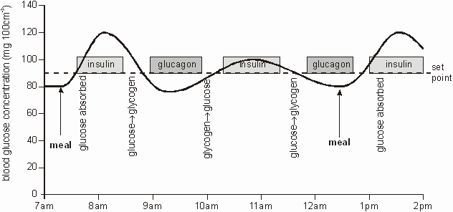
Example of Homeostasis
Blood sugar level homeostasis
Positive and negative feedback system

Slide 5
Excretion is part of Homeostasis
Excretion refers to the wastes that cells produce, and the waste that organisms produce
How is this part of homeostasis?
Think about what would happen at home if you never took out the trash?

Slide 6
WHY IS EXCRETION IMPORTANT?
Wastes include toxic chemicals, as well as excess amounts of nontoxic materials.
If these wastes are not eliminated, the ability of an organism to function is drastically reduced.

Slide 7
How Does Excretion Happen?
At the cellular level
At the organismal level

Slide 8
Excretion in a single cell
WHAT WASTES DO CELLS EXCRETE?
Water, carbon dioxide, salts, urea, etc
ORGANELLES INVOLVED: cell membrane
i.e. diffusion, osmosis, active transport, etc

Slide 9
Excretion in Multicellular Organisms (i.e. humans and other mammals)
WHAT WASTES DO ORGANISMS EXCRETE?
Water, urea, carbon dioxide, salts
BTW: What is Urea?
Urea is a less toxic package of wastes produced by the liver when it breaks down other compounds. Urea enters the blood at the liver and is removed from the blood by the kidneys
ORGANS INVOLVED:
Kidneys, skin, lungs, liver
Together, these organs make up the EXCRETORY SYSTEM

Slide 10
Which other organ systems help with excretion?
The Circulatory System plays an important role in the elimination of wastes.
Wastes are carried BY THE BLOOD (circulation) to THE KIDNEYS (for diffusion and filtration) and LUNGS (for elimination of CO₂ and excess H₂O)

Slide 11
Organ | Function
Kidney | filter out excess water and urea (Urinary System)
Lungs | filter out carbon dioxide, CO2, from the blood (Respiratory System).
Skin | excretes water, as sweat, which contains some trace chemical wastes, including urea (Integumentary System).

Slide 12
The Kidneys
Every drop of blood in your body is filtered by your kidneys more than 300 times per day!
Kidneys eliminate urea, minerals and excess water.
Kidneys regulate the amount of water we need to maintain in our bodies.

Slide 13
Each part plays a role!
Kidneys – filter wastes and excess water from the blood.
Nephron – Filter found in the kidneys that removes wastes from blood and produces urine.
Ureters – tubes that take urine from the kidney to the bladder.
Bladder – a sack that stores urine.
Urethra – small tube that leads urine out of the body.
Urine – Fluid produced by the kidneys that contains urea and other wastes.

Slide 14
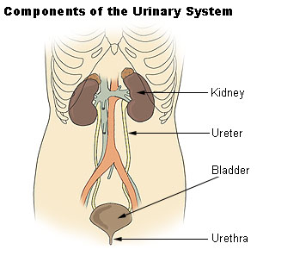

Slide 15
Signs of Disease
Doctors analyze urine for disease;
Normal urine contains water, urea and trace minerals.
Sugar in urine indicates Diabetes
Protein in urine indicates the kidneys are not working and the person, or animal, is very sick.

